Slide 1
PURDUE P2SAC- Safety shower and eyewash system
STUDENT:
Xinyu Zhen
MENTOR:
Dr. Ray A. Mentzer
05/14/2021

Slide 2
Summary
This project is about safety shower and eyewash system survey results and recommended best practices. CountryMark, SABIC and 3M participated in an effort to develop and conduct a survey of issues with the use of safety shower and eyewash units in refinery, chemical and manufacturing facilities.
Eleven responses were received from: Tate & Lyle, Celanese, Cummins, 3M, Marathon, CountryMark, Corteva, American Chemistry Council, SABIC (Mount Vernon, IN), SABIC (Ottawa, IL), and QualEx.
Survey questions were summarized in six categories: a. General; b. Water source; c. Corrosion; d. Maintenance, training, and management systems; e. Self-contained devices; f. Other issues or comments. All results are provided in a 52-page report.

Slide 3
Official Standards & Requirements
ANSI/ISEA Z358.1-2014, American National Standard for Emergency Eyewash and Shower Equipment
The most widely adopted and accepted standard currently in the United States
29 CFR 1910 - Occupational Safety and Health Standards
EN 15154 – Emergency Safety Showers
Standards adopted in Europe
Canadian Centre for Occupational Health and Safety (CCOHS) fact sheets

Slide 4
SURVEY RESULTS: General
1 Manufacturer | 3/11: ENCON 2/11: Bradley; BLS; HAWS Other: Honeywell, Guardian, or not sure | 4 Signage | 100%(11/11): Yes 4/8: Bright colors 3/8: Wall signs & Floor markings 2/8: Indicator lights 8 companies mention the details of signage
2 Number of systems per unit | Varies from 1 to 500. 63.6%(7/11) <100 36.4%(4/11): >100 | 5 Ways to activate | 100%(11/11): Hand/Foot
3 Factors to consider in number and placement | 8/11: Distance from hazard 7/11: Hazard of substances 6/11: No partitions/constructions 1/11: Areas with less personnel 1/11: Likelihood of exposure | 6 Alarm systems | 54.5%(5/11): Yes 45.5%(6/11): No/Not common

Slide 5
Best Practice: General
Provide highly visible signage;
Position wall signs and indicator lights;
Painted trails;
Train the employees on how to get to the nearest station;
Ensure the stations can be accessed within 10 seconds. (55 ft or 16.8 m, same floor);
Resolve any obstructions/partitions (including doors);
Professionals should be contacted for advice;
Consider the access of responding emergency response personnel to the injured individual(s).
Select safety shower and eyewash equipment that does not need additional operations once activated.
Install alarm systems.

Slide 6
SURVEY RESULTS: Water Source Issues
1 Tempered water system | 54.5%(6/11): Yes 45.5%(5/11): No | 4 Anti-scalding devices | 63.6%(7/11): No 36.3%(4/11): Yes --Depends on the units
2 Freezing problem | 90.9%(10/11): No or Not mentioned 9.1%(1/11): Yes | 5 Drainage | Runs to the drain Chemical sewer Treatment plant
3 Heat trace | 72.7%(8/11): Yes 27.3%(3/11): No | 6 Scale buildup | 7/11: No 3/11: Yes Prevention/Solution: 4/8: Flush units 3/8: Chemically treated or regularly tested

Slide 7
Best Practice: Water Source Issues
Install tempered water system; (60.8 °F to 100.4 °F)
Outdoor stations & cold climates: heat trace the piping and install an enclosure;
Outdoor stations & hot climates, install anti-scalding devices;
Installing flushing units;
Fine mesh filters are strongly recommended;
Perform weekly activation of the equipment;
Test the systems regularly and keep a record;
Develop a drainage system;
Water treatment is recommended;
Consult authorities for assistance with regulations about the criteria for drainage.

Slide 8
SURVEY RESULTS: Corrosion Issues
1 Experienced corrosion | 63.6%(7/11): No 36.4%(4/11): Yes
2 Preventive methods | Non or low corrosive materials Periodically flush the units Replace the piping when cannot handle pressure
3 Piping materials | 7/11: Stainless steel 5/11: Galvanized steel 2/11: Plastic 2/11: Carbon steel 2/11: Copper/Metal 1/11: Steel *some responded with multiple types

Slide 9
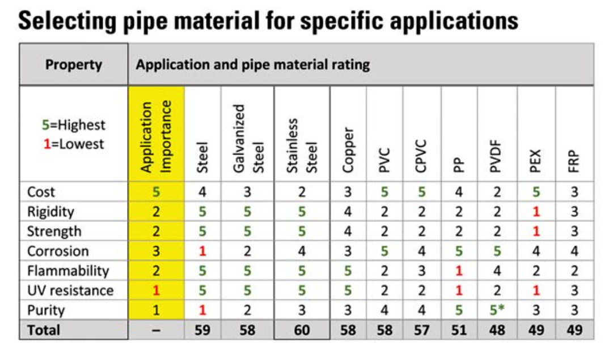
Best Practice: Corrosion Issues
Select highly corrosion resistant materials;
Avoid using steel for piping materials;
Note that these recommendations are based on preventing corrosion, and that the ranking would differ from an overall ‘Total’ perspective.
PVC (Polyvinylchloride)
PP (Polypropylene)
PVDF (Polyvinylidene fluoride)
https://www.csemag.com/articles/selecting-pipe-and-piping-materials/

Slide 10
SURVEY RESULTS: Maintenance , Test, Management
1 Frequency of test | 54.5%(6/11): Monthly 45.5%(5/11): Weekly
2 Preventive maintenance protocol | 2/11: ANSI Z358.1 1/11: do not have one Many companies did not respond
3 Management of Change | 90.%(9/10): Yes 10%(1/10): No
4 PreStartup Safety Review | 90%(9/10): Yes 10%(1/10): No
5 Employee training | 100%(11/11): Yes

Slide 11
Best Practice: Maintenance , Test, Management
Activate the safety shower and eyewash systems weekly;
Test the systems on a monthly basis and record the details of each test.
Clean the tanks that supply the water annually;
Problems arising during testing should be solved as soon as possible;
Operation, inspection, and maintenance instructions should be readily accessible to all employees;
Training should include the location and the proper use of safety shower and eyewash units;
Add the consideration of safety shower and eyewash systems into MOC and PSSR.
A (separate) checklist is recommended for operation and installation procedures.
Records should be kept for every change.

Slide 12
SURVEY RESULTS: Self-contained Devices
1 Have self-contained devices | 63.6%(7/11): Yes 27.3%(3/11): No 9.1%(1/11): Not sure
2 Bacteriostatic additives | 28.6%(2/11): Yes 71.4%(9/11): No
3 Change of eyewash solutions | 3/7: Per manufacturer recommendations 1/7: 2 years 1/7: 6 months 1/7: Not always changed as recommended 1/7: Do not have a program to check

Slide 13
Best Practice: Self-contained Devices
Provide sufficient number of easily accessible self-contained devices in each unit.
Add bacteriostatic additives as per manufacturer.
Train employees on operating self-contained devices.
Change the water in the bottle per manufacturer’s recommendation.

Slide 14
SURVEY RESULTS: Other issues or comments
Celanese | Important to consider spare parts in selection of the safety shower/eyewash systems. Also, a challenge to install shower curtains.
3M | We use an electronic barcode system to track weekly and annual inspection/PM completions.
QualEx, Marathon | In the last 6 - 7 years, Marathon has implemented an extensive program to upgrade the safety shower & eyewash equipment to go above and beyond complying with the requirements in OSHA and 29CFR1910.151.
SABIC-Mount Vernon, IN | Interested in the material of construction from other companies.
QualEx(General design parameters, experience with clients) | ANSI Z358.1 is an informative reference that touches many aspects of the safety shower system. For tempered water systems the quality of the steam should be considered. From the International Plumbing Code 2006, if the heating media is not potable then the heat exchanger should be double walled to minimize risk of contamination.

Slide 15
Thank You!
Questions?

